Slide 1

Expedia’s Advertisement Strategy in Relation to Mobile User Type
Jin Cao Anisa Kabir
Riva Lam
Katelyn Rainville
Miranda Zhang

Slide 2
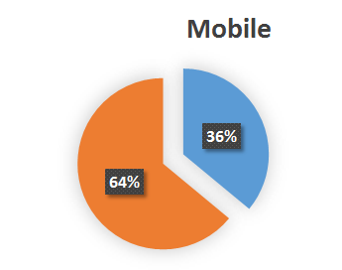
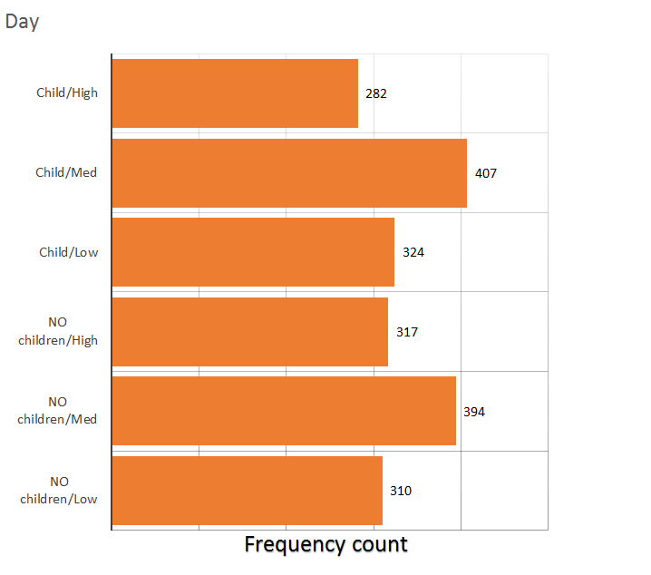
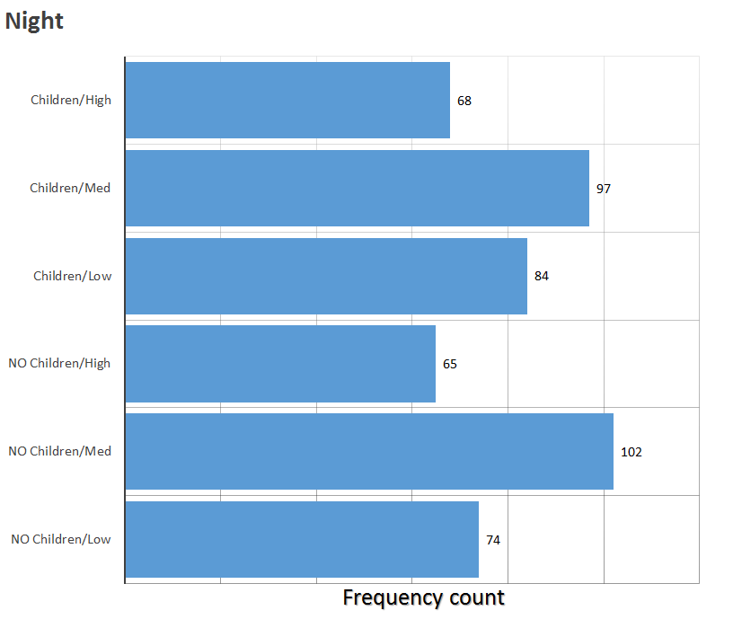

Slide 3
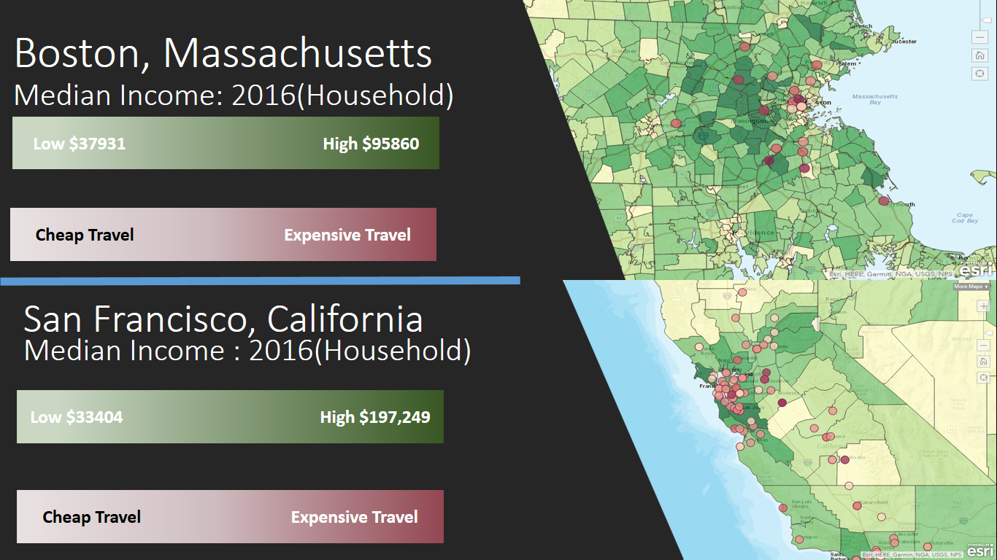

Slide 4
In conclusion
A good approach would be for Expedia to advertise in a certain way that targets towards:
Affordable travel destinations, since a greater portion of night-time and day-time users are interested in traveling to medium-price range travel destinations.
Cheaper travel destinations for night-time users, since there is a clear proportion of individuals with children who are interested in traveling to low-price destinations.
Which may have the potential to increase target customers
Cluster of dark points in a dark shaded region means that there is some trend with users with high household median income and travelling extensively. We can use GPS information on phone to decide what type of advertisement should put on their app.

